Slide 1




Probabilistic Representation of Intent Commitments to Ensure Software Survival (PRINCESS) PI Meeting Research Presentation
Prepared for: Dr. Sandeep Neema DARPA/I2O
27 November 2017
Presented by: The PRINCESS team

Slide 2
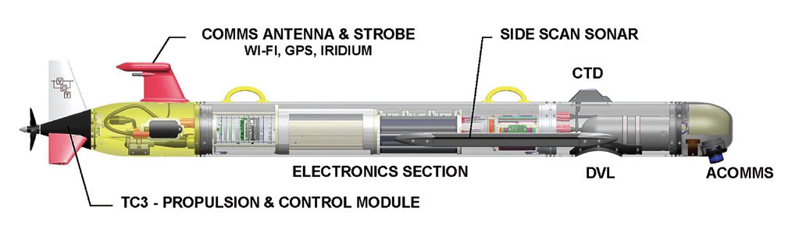
Project Goal: Software Adaptation for a REMUS UUV
Challenges:
System failures in autonomous missions
Changing and uncertain environment
Long-lived platforms
Research goals
Adapting sensor processing to sensor failures during a mission
Adapting the software to other failures and environmental changes during a mission
Updating the OS to a new hardware platform to support long life

Slide 3
Making Non-Adaptive Software Adaptive

Slide 4
From Phase 1 to Phase 2
We adapt software by setting the values of control variables to optimize intent metrics
Phase 1 assumption: The software component has predefined controllable knobs with well-understood semantics
But what if the component has no controllable knobs at all?
Can we turn a software component with no support for adaptation into a resilient, adaptive component?

Slide 5
Making a Non-Adaptive Component Adaptive
Ball and Cloud Metaphor
Transform legacy code into adaptive code by increasing its range of behavior
Make fixed aspects of code variable parameters
Learn a model of the behavior of the adapted code in different situations under various settings of the parameters
Use the model to choose the best parameters for a situation

Slide 6
Transforming a Component

Slide 7
Generating a Component Model

Slide 8
Running the Transformed Component

Slide 9
Practical Application: UUV Path Planner
Mission is to find an object on the ocean floor
Given a region of the ocean floor to explore, path planner sets of series of waypoints to traverse
But a battery has failed, so we’re constrained by power usage
Goal is to find a path that has maximal probability of finding the object, subject to power constraint
Legacy path planner has no notion of power and no controllable knobs, other than region to explore

Slide 10
Example: Path Planner Before Transformation
public double[][] Plan(
double startLocationX, double startLocationY, double returnLocationX,
double returnLocationY, double[][] searchArea, int numPts,
double altitude, double fovRadians) {
...
double boundsHeight = boundsMaxY - boundsMinY; double viewSize = 2.0 * altitude * Math.tan(fovRadians); int legs = (int)Math.ceil(boundsHeight / viewSize) - 1 ; if(legs <= 1 ) { legs = 1 ; viewSize = boundsHeight; } double halfViewSize = viewSize / 2.0 ; double crossDirX = 0.0 ;
...
// Main loop calculating coordinates of each point in path
for(int i = 0; i < legs ; i++) {
... <References to variables defined above> ...
}
...
}

Slide 11
Example: Path Planner After Transformation
public double[][] TransformedPlan(double ctrlLoop1, double ctrlCmp0,
double ctrlConst0, double ctrlConst1, double ctrlConst2,
double ctrlConst3, double ctrlConst4,
double startLocationX, double startLocationY, double returnLocationX,
double returnLocationY, double[][] searchArea, int numPts,
double altitude, double fovRadians) {
...
double boundsHeight = boundsMaxY - boundsMinY; double viewSize = /*2.0*/ ctrlConst0 * altitude * Math.tan(fovRadians); // Transformed int legs = (int)Math.ceil(boundsHeight / viewSize) - (int)ctrlConst1 /*1*/; // Transformed if(legs <= 1 + ctrlCmp0) { // Transformed legs = (int)ctrlConst2 /*1*/; // Transformed viewSize = boundsHeight; } double halfViewSize = viewSize / ctrlConst3 /*2.0*/; // Transformed double crossDirX = ctrlConst4 /*0.0*/; // Transformed
...
// Main loop calculating coordinates of each point in path
for(int i = 0; i < legs + ctrlLoop1; i++) { // Transformed
... <References to variables defined above> ...
}
...
}
// New control
// parameters

Slide 12
Generating a Simulated Dataset
Need to consider controls, inputs/environment, and metrics
Controls
Inputs/Environment
Metrics
ctrlLoop1 | ctrlCmp0 | ctrlConst0 | ctrlConst1 | ctrlConst2 | ctrlConst3 | ctrlConst4 | Search Area Width | Search Area Height | Altitude | Distance | Pr(Detection)
-1 | -1 | 1 | -1 | -1 | -1 | -1 | 111 | 111 | 50 | 602.9408052 | 0.25
-1 | -1 | 1 | -1 | -1 | -1 | -1 | 211 | 111 | 50 | 997.9176481 | 0.166666667
-1 | -1 | 1 | -1 | -1 | -1 | -1 | 311 | 111 | 50 | 1396.039167 | 0.125
-1 | -1 | 1 | -1 | -1 | -1 | -1 | 411 | 111 | 50 | 1795.064898 | 0.1
-1 | -1 | 1 | -1 | -1 | -1 | -1 | 511 | 111 | 50 | 2194.469898 | 0.083333333
0 | -1 | -1 | -1 | 1 | -1 | -1 | 211 | 111 | 50 | 560.4156035 | 0.166666667
0 | -1 | -1 | -1 | 1 | -1 | -1 | 311 | 111 | 50 | 752.2150814 | 0.125
0 | -1 | -1 | -1 | 1 | -1 | -1 | 411 | 111 | 50 | 947.7252635 | 0.1
0 | -1 | -1 | -1 | 1 | -1 | -1 | 511 | 111 | 50 | 1144.916819 | 0.083333333
0 | -1 | -1 | -1 | 1 | -1 | -1 | 211 | 211 | 50 | 720.3990617 | 0.111111111
1 | -1 | -1 | -1 | 0 | 1 | 1 | 111 | 311 | 50 | 752.2150814 | 0.375
1 | -1 | -1 | -1 | 0 | 1 | 1 | 211 | 311 | 50 | 897.8217663 | 0.333333333
1 | -1 | -1 | -1 | 0 | 1 | 1 | 211 | 311 | 75 | 897.8217663 | 0.416666667
1 | -1 | -1 | -1 | 0 | 1 | 1 | 211 | 311 | 100 | 897.8217663 | 0.5
1 | -1 | -1 | -1 | 0 | 1 | 1 | 311 | 311 | 50 | 1061.820418 | 0.25
✗
✓

Slide 13
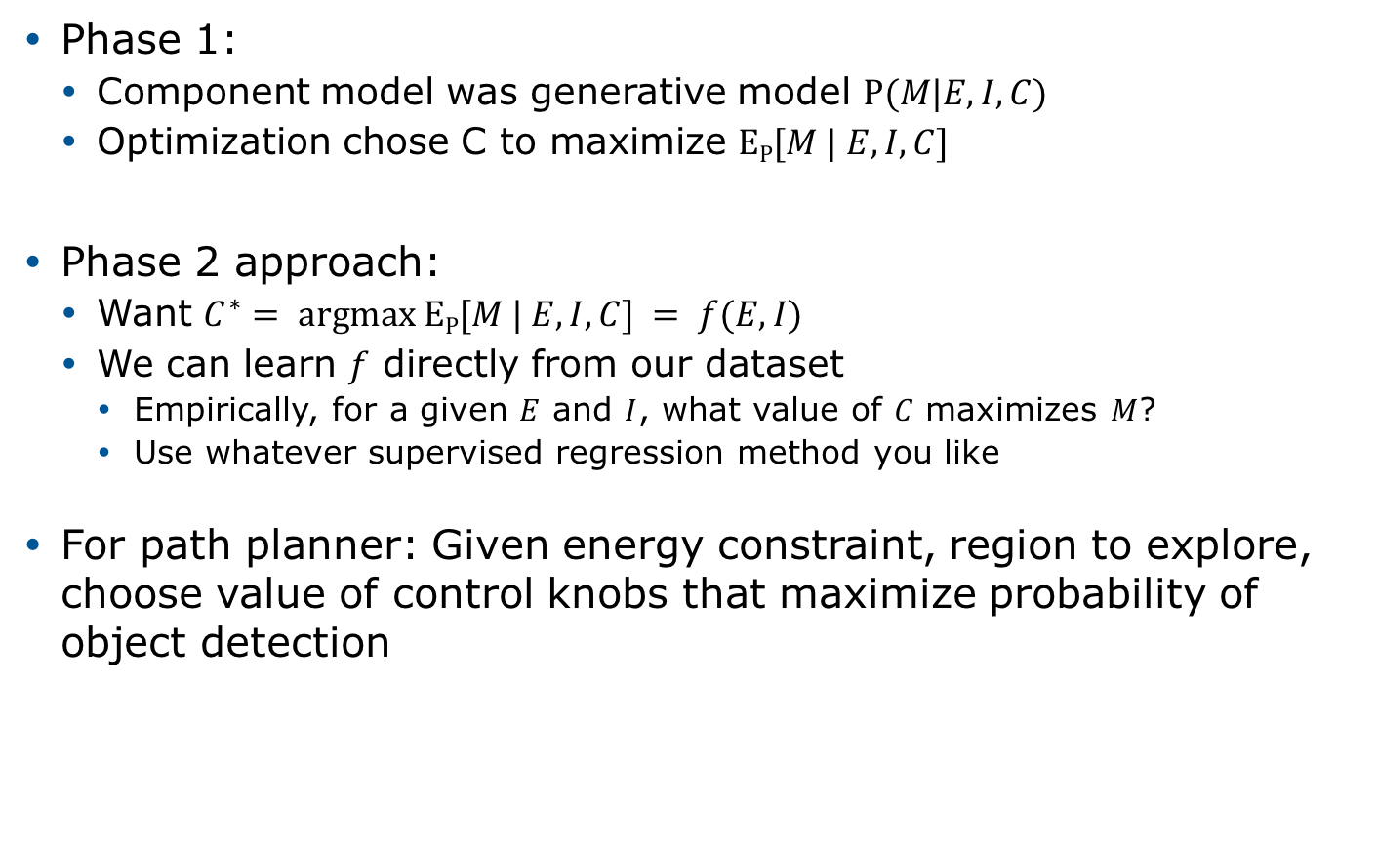
Optimization
Phase 1:
Component model was generative model $P(M|E, I, C)$
Optimization chose C to maximize $EP[M | E, I, C]$
Phase 2 approach:
Want $C^{∗}= argmax EP[M | E, I, C] = f(E, I)$
We can learn $f$ directly from our dataset
Empirically, for a given $E$ and $I$, what value of $C$ maximizes $M$?
Use whatever supervised regression method you like
For path planner: Given energy constraint, region to explore, choose value of control knobs that maximize probability of object detection

Slide 14
Experimental Results

Slide 15
Integrating Verification
Since we’re optimizing based on a model of a black-box component, it’s not unlikely we’ll make bad choices
We integrate PRISM probabilistic verification using PRISM
Make sure the path we produce is reasonable and doesn’t put us in danger of running out of power
New verification results
Novel methods for generating probabilistic time-bound guarantees
E.g., probability of UUV completing mission within 5 mins is >0.99
Two phase verification: initial exploration of Pareto front on coarser untimed model, then generate guarantee from pruned model
New techniques for more reliable generation of probabilistic guarantees, despite numerical approximations
“interval iteration” converges simultaneously from above and below, detecting and quantifying numerical errors that may occur

Slide 16
Adaptation to Sensor Changes

Slide 17
Overview
Problem: Learning to adapt to sensor changes and failures
Our Previous work
Learning a sensor reconstruction function
Exploiting previously unseen sensors to improve the reconstruction [Shi & Knoblock, IJCAI’17]
Current focus
Identifying sensor failures
Automatic data normalization for sensor reconstruction

Slide 18
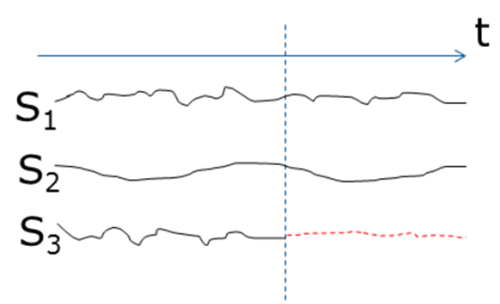
Sensor Failure Detection and Adaptation
Setting: a set of sensors generating sensor readings continuously
Problem
Detect if there is sensor failure
Identify the failed sensors and failure type
Reconstruct the failed sensors from the remaining working sensors
Estimate the reconstruction error
fail or not?

Slide 19
Approach – Sensor Failure Detection
Step 1: Learn the relationships among sensors from historical data
Step 2: Infer failed sensors online
Check each group to see whether its error bound being violated: if so, then at least one sensor within the group may have failed
Use logical inference to identify the failed sensor(s)
Step 3: Infer the failure type
Failure types: outlier, spike, stuck-at, high noise, miscalibration
Based on sensor readings within a time window
S₁
S₂
S₃
S₄
S₅
Hierarchical Groups
Cluster signals based on their correlations
S₁ S₂ S₃ S₄ S₅
(S₁ S₂) (S₃ S₄ S₅)
represent the relationship within a group via an error bound
(2S₃ + 3S₄ – S₅ – 0.5)² < 0.2²

Slide 20
Approach – Sensor Failure Adaptation
Adaptation: Reconstruction and Estimating Error Bounds
Reconstructing failed sensors by using the remaining working ones and the corresponding reconstruction functions
Estimating reconstruction error bounds from similar historical data
S₁
S₂
S₃
S₄
S₅
S₅ = f(S₃, S₄)
reconstruction functions are learned from historical data
X
S₁
S₂
S₃
S₄
S₅
…
…
f(S₃, S₄) S₅
reconstruction error:
1.2
0.8
1.5

Slide 21
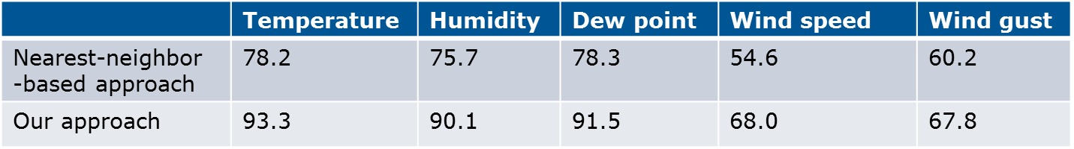
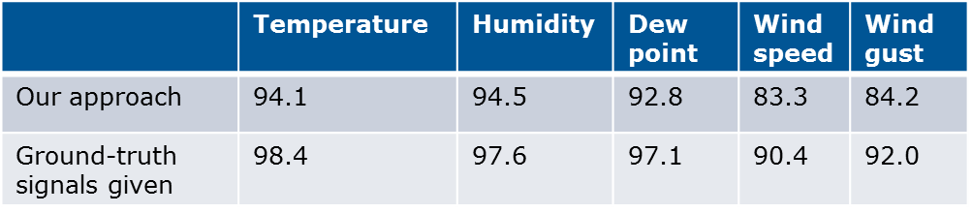
Preliminary Results on Detecting Sensor Failures
Data: One year data from a San Francisco weather station (source: Weather Underground)
Five types of sensor failures are simulated. If the deviation between observed signal and ground truth exceeds a threshold, then a failure is identified
Single-sensor and multi-sensor failures are simulated
Recall is set to 90%
Use single-sensor signals only, not leveraging correlated sensors
Precision of detecting failures
ground-truth signal
Accuracy of identifying failure types
observed signal

Slide 22
Automatic Data Normalization for Sensor Reconstruction
Problem Example:
Desired data
Feb 5, 1985
Jun 24, 1987
Dec 19, 1987
...
Input format
12.06.1979
04/06/87
13/01/91
...
Output
Dec 6, 1979
Jun 4, 1987
Jan 13, 1991
...
String transformation

Slide 23
String Clustering and Template Generation
Approach
Partition 1
Variable 1 | . | Variable 2 | . | Variable 3
12 | . | 06 | . | 1979
03 | . | 15 | . | 1993
10 | . | 03 | . | 1981
... | ... | ... | ... | ...
Data
12.06.1979
04/06/87
13/01/91
03.15.1993
10.03.1981
27/12/62
Clustering
+
Template generation
Partition 2
Variable 1 | / | Variable 2 | / | Variable 3
04 | / | 06 | / | 87
13 | / | 01 | / | 91
27 | / | 12 | / | 62
... | ... | ... | ... | ...

Slide 24
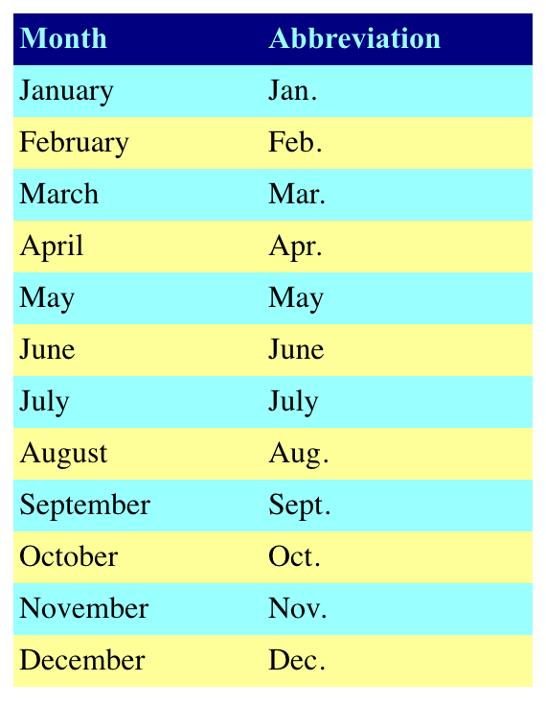
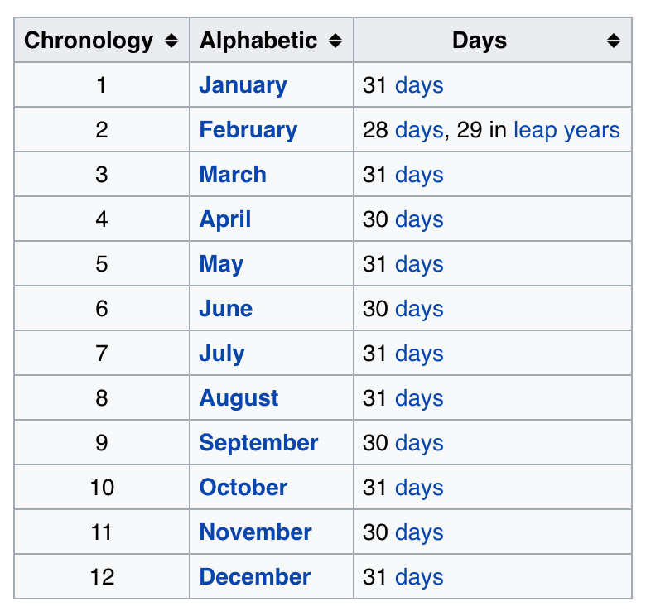
Variable Alignment and Data Mapping
Approach
Web tables
Partition 2
Variable 1 | / | Variable 2 | / | Variable 3
04 | / | 06 | / | 87
13 | / | 01 | / | 91
27 | / | 12 | / | 62
... | / | ... | / | ...
Extract transformations from
web tables
Data transformation
Desired Output
Variable 1 |  | Variable 2 | , | 19 | Variable 3
Feb |  | 5 | , | 19 | 85
Jun |  | 24 | , | 19 | 87
Dec |  | 19 | , | 19 | 87
... |  | ... | , | ... | ...
06
01
12
...
Jun
Jan
Dec
...

Slide 25
Results on Data Normalization
Datasets
35 different scenarios: date/time, people names, addresses, dimensions and other format changes
Best scenario system:
IPBE (Wu et al, IUI 2014)
Supervised: requiring aligned input-output examples
Our system is unsupervised
Result:
System | Accuracy | Edit distance reduction
Our system | 0.80 | 93.68%
IPBE | 0.87 | N/A

Slide 26
Adaptation to New Computing Hardware

Slide 27
New Methods for OS Synthesis
Synthesized
Code
Machine
descriptions
bintools
Instruction Encodings
Language Syntax
Operating
System
Assembler
OS DSL
Hazard Specifications
Relocations
Linker
Machine independent
Operating System code
Notes:
There are two parts to our work:
A retargetable assembler/linker, so that we can rebuild all mission software as new HW becomes available; the goal is to allow embedded systems like UUVs to use more recent hardware platforms for command control than has traditionally been the case. So, we want to expedite the constructoin of both the toolchain (e.g., assembler/linker) and the operating system.
The toolchain uses a generalizable expression of:
Instruction encodings
Language syntax
Relocation expression
Hazard description
To CLICK enable push-button production of a new assembler/linker – we’ve talked about that work at past meetings, so I’m going to skip that today and focus on our OS work.
-- we’ve talked about this before and it was largely the target of Phase I eval, so while it is more complete now and will be evaluated in Phase II, I’m going to focus on our OS synthesis work.
2. Guppy is a Barrelfish derivative, whose machine dependent portions are expressed via a combination of an OS DSL called ALEWIFE, a machine description language called CASSIOPEA, and ultimately code-synthesis to produce a CLICK complete operating system

Slide 28
New Methods for OS Synthesis
Synthesized
Code
Machine
descriptions
bintools
Instruction Encodings
Language Syntax
Assembler
OS DSL
Hazard Specifications
Relocations
Linker
Machine independent
Operating System code
Notes:
The vision is that the Alewife code is written once (in the same way machine independent code is written “once”)
To port the operating system to new computing platforms we write CASSIOPEA machine descriptions
(CLICK)
To produce the machine-independent code.
Ideally, this is a signficantly smaller effort (CLICK) than hand-writing a port.
That said, experience suggests that push-button entire kernel synthesis might be a bit of a stretch …

Slide 29
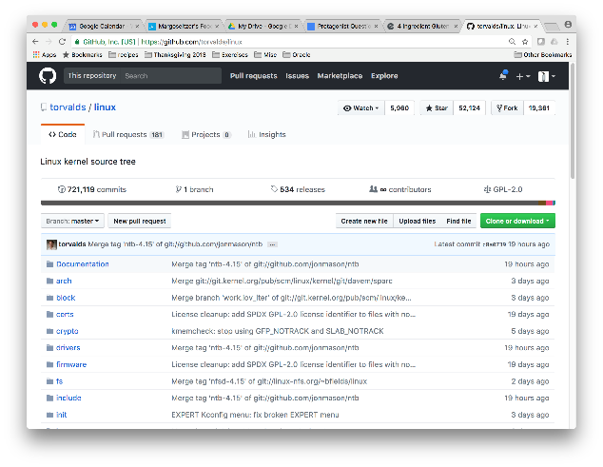
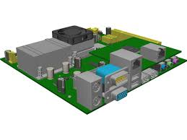
OS synthesis
OS Source Code
Machine dependent code
Machine independent code
C/asm
asm/C
Alewife
Compile and link
Cassiopea
specification
Notes:
So, let’s look at how we do this:
We take an existing Operating System (in our case the Barrelfish Multikernel), which is already decomposed into machine dependent and machine independent parts.
Now, we rewrite the machine DEPENDENT parts in our OS DSL, Alewife (which I’ll show you in a moment) CLICK – Alewife is a MACHINE INDEPENDENT way to express the specifications of fragments of OS code. This means that we write the Alewife code once, and never have to modify it for a new port.
Another way to think of Alewife is as C header files with specifications.
Meanwhile, we write a machine description for our HW platform in a DSL called Cassiopea (which I’ll also show you in a moment) CLICK which is a MACHINE DEPENDENT model of a piece of HW. This gets written once per port, but is intended to be significantly less work than writing the entire port.
CLICK By combining these two specification, we synthesize the MACHINE DEPENDENT C/Assembly code that completes our kernel, which (CLICK) gets linked together to form an operating system.

Slide 30
OS synthesis
OS Source Code
Machine dependent code
Machine independent code
C/asm
asm/C
Alewife
Compile and link
Cassiopea
specification
Notes:
When we get new HW, the only part that should have to change is the CASSIOPEA description of the HW:

Slide 31

From Source Code to Alewife to Cassiopea
MD-source
Alewife
Synthesized MD code
Cassiopea
Notes:
So, the 10,000 foot view is that we take an Alewife specification written once and for all by a kernel engineer, a Cassiopea specification describing a new piece of hardware and we synthesize the machine dependent code that enables the Alewife program to support the new hardware.

Slide 32
Example: Machine Dependent Source -> Alewife
Machine-independent
handler
Barrelfish ARM
system call handler
swi_handler:
assert(is_valid_syscall())
if (from_kernel_mode())
kernel_syscall()
else
user_syscall()
swi_handler:
if SYSCALL_REG <> 0
.error “Syscall entry broken…”
.endif
// Are we in kernel mode?
stmfd sp!, {r0-r3}
mrs r3, spsr
ands r1, r3, #ARM_MOD_PRIV
bne $swi_kernel
// Code for call from user space here
…
$swi_kernel:
ldr r3, got_syscall_kernel
ldr pc, [PIC_REGISTER, r3]
Alewife
predicate is_valid_syscall()
predicate from_kernel_mode()
predicate in_kernel_handler(Addr pc)
predicate in_user_handler(Addr pc)
proc kernel_syscall() :
@requires(from_kernel_mode())
@guarantees(in_kernel_handler(pc))
proc user_syscall()
@requires(!from_kernel_mode())
@guarantees(context_saved() &&
in_user_handler(pc))
Notes:
Let’s look at this in practice.
Here is a piece of real MD code from the Barrelfish operating system for the ARM system call handler
We rewrite this in two parts:
CLICK machine INDEPENDENT code that invokes small MACHINE DEPENDENT functions
CLICK ALEWIFE (also Machine independent) code that states the specifications for the MACHINE DEPENDENT FUNCTIONS [slightly abbreviated to fit on the slide)
We have two kinds of statements in Alewife:
Predicates: procedures that evaluate to a boolean value
Procedures: more general functions, specified by a pre-condition and a post-condition

Slide 33
Example: Bridging from Alewife to Cassiopea
Cassiopea (machine semantics)
Alewife
let word = 32 bits
let halfword = 16 bits
let a32_reg = word reg
…
// left shift logical no carry
Defop lsl rd: a32_reg rn: a32_reg shift: halfword {
txt: “lsl “ + rd.txt + rn.txt + text_of(shift),
sem: *rd <- *rn <_l shift
}
predicate is_valid_syscall()
predicate from_kernel_mode()
predicate in_kernel_handler(Addr pc)
predicate in_user_handler(Addr pc)
proc kernel_syscall() :
@requires(from_kernel_mode())
@guarantees(in_kernel_handler(pc))
proc user_syscall()
@requires(!from_kernel_mode())
@guarantees(context_saved() &&
in_user_handler(pc))
Cassiopea (mappings)
map ARM_is_valid_syscall is_valid_syscall
map ARM_in_kernel_handler in_kernel_handler
map ARM kernel_syscall kernel_syscall
…
Cassiopea (definitions)
predicate ARM_is_valid_syscall() {
return (SYSCALL_REG != 0)
}
predicate ARM_in_kernel_handler(Addr A) {
return (A > (regs[PIC_REGISTER]) &&
A < (regs[PIC_REGISTER] + MAX_SYSCALL))
}
proc ARM_kernel_syscall() {
regs[PC] = regs[PIC_REGISTER] + 4 * regs[3]
}
Notes:
Cassiopea files have three parts -
CLICK Semantic descriptions of the machine, including a model of the actual CPU state adapted from the reference manual.
CLICK Mappings
CLICK Definitions of the predicates and procedures needed.
Now, the interesting part is that although we are currently writing these (CLICK) descriptions by hand, the pre/post conditions in Alewife CLICK provide specifications for the Cassiopea functions CLICK, so that we can synthesize them; thus we really never have to write these (CLICK)
<Pause for questions; then if time, talk about bintools>
NOTES:
Getting from here to there:
Cassiopea: Basically a macro compiler
ALEWIFE
predicate is_dev_ready(Device d)
proc getDeviceReady(Device d)
@require(true)
@guarantee(is_dev_ready(d) == TRUE)
CASSIOPEA
Machine description (32 registers(1…32) each of 32 bits)
addl r-d, r-s : r-d = r-d + r-s
ld R, ADDR ; contents of addr are in R
BRIDGE the gap between the low level machine description and the high level predicates
// We start writing this by hand; ultimately we want to synthesize this – the reason this is part of cassiopea is because it has to
// manipulate things that look like the stuff Cassiopea is describing
// We should also be able to verify that the implementation at the Cassiopeal level meets the requirements of the Alewife level
predicate my_is_dev_ready(Device d) {
return MEM[d.status_addr] != 0
}
proc my_get_dev_ready(Device d) {
do {
a = MEM[D.status_addr
} until a != 0
Create a mapping between is_dev_ready and my_is_dev_ready

